Slide 1
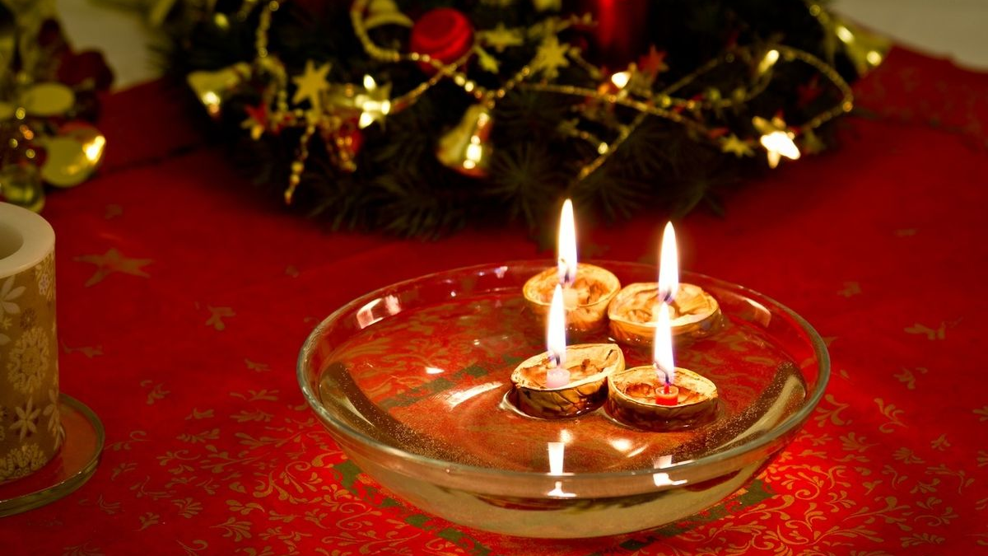
Christmas in the Czech Republic
Elementary School Sezemice

Slide 2
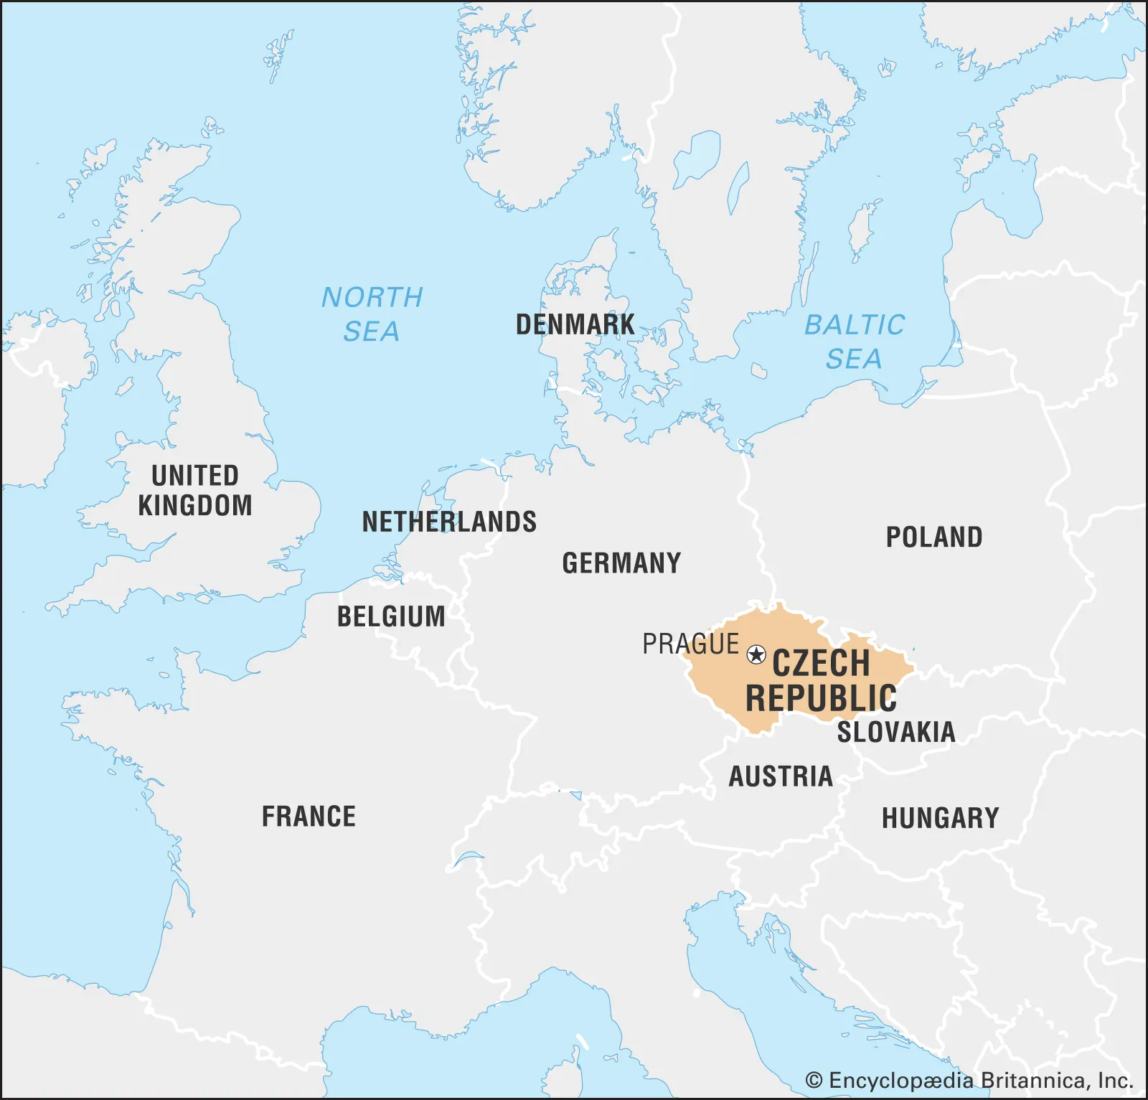
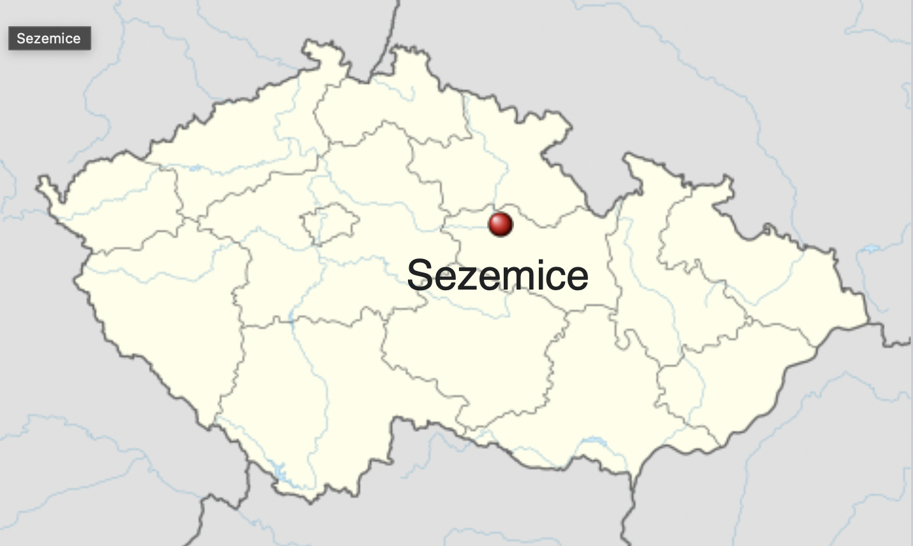
Where are we from?
we’re from the CZECH REPUBLIC, and speak the Czech language
our climate is mild, and we have four seasons
our typical foods often include dumplings, sauces, pork or beef, and sauerkraut

Slide 3
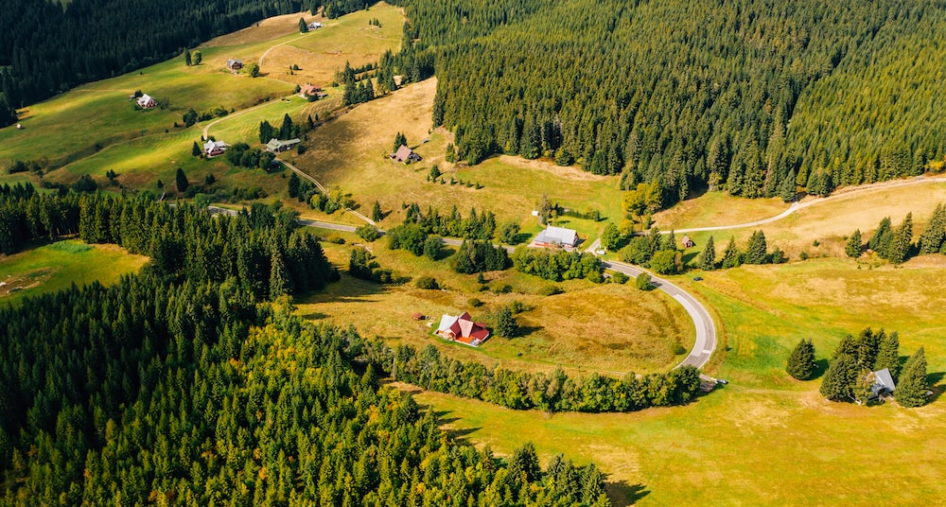
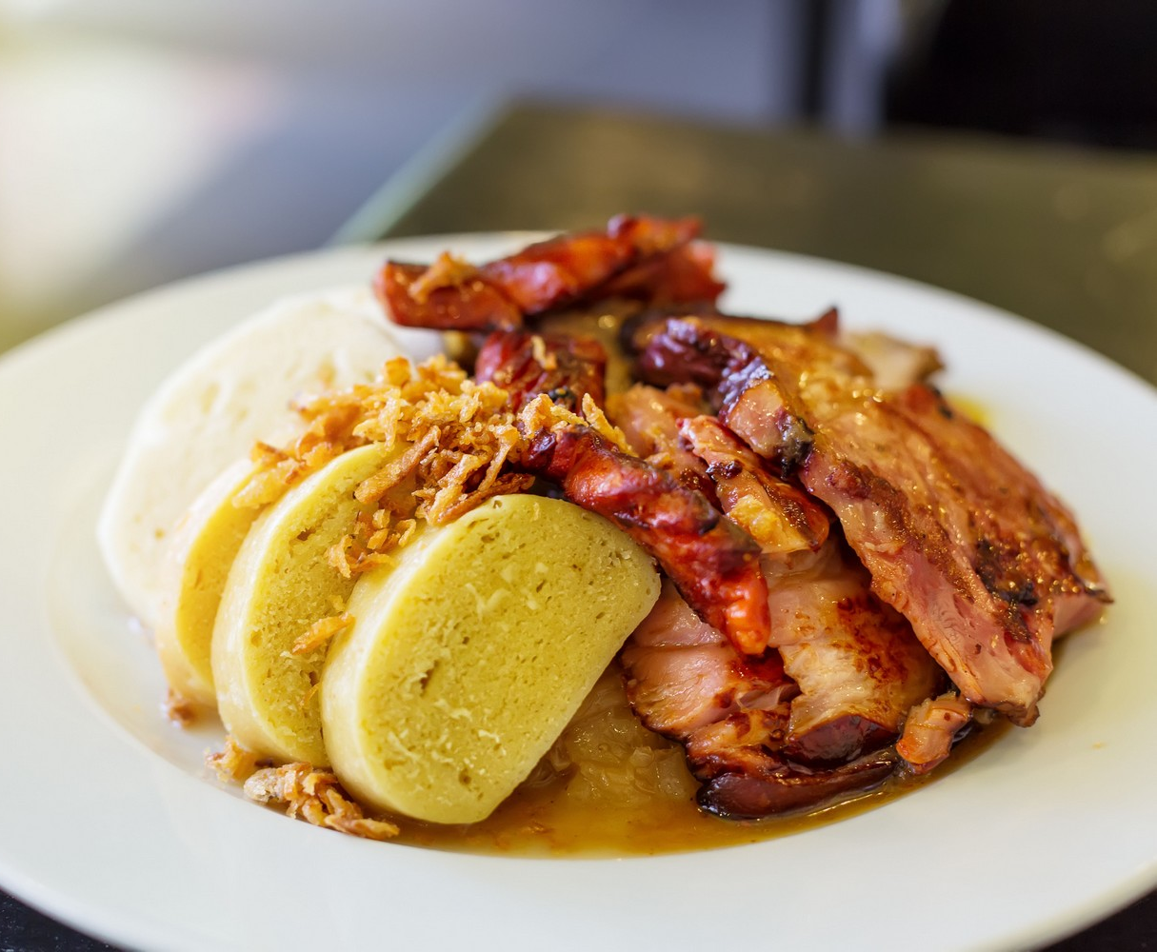
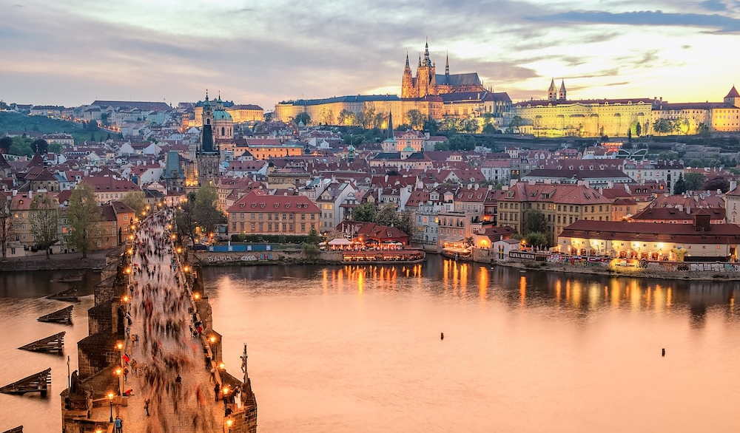
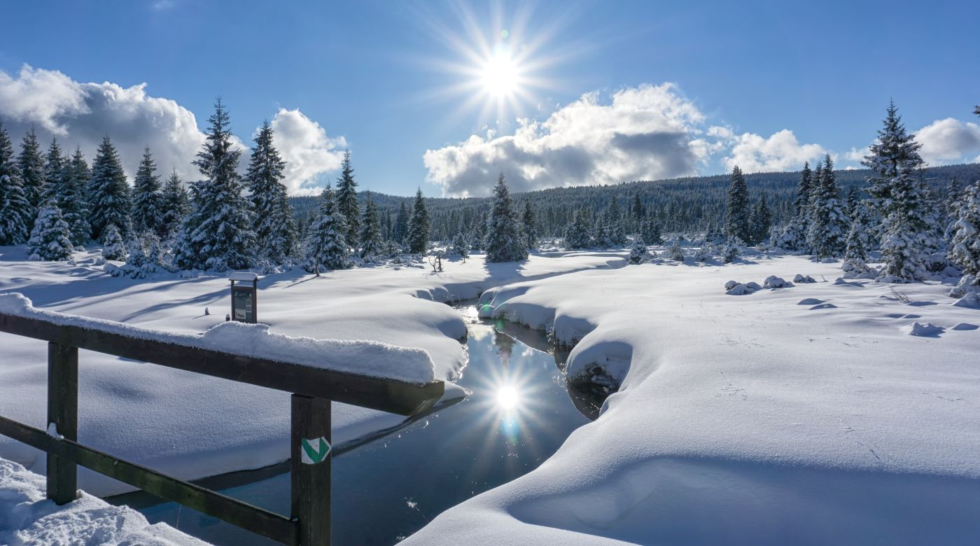

Slide 4
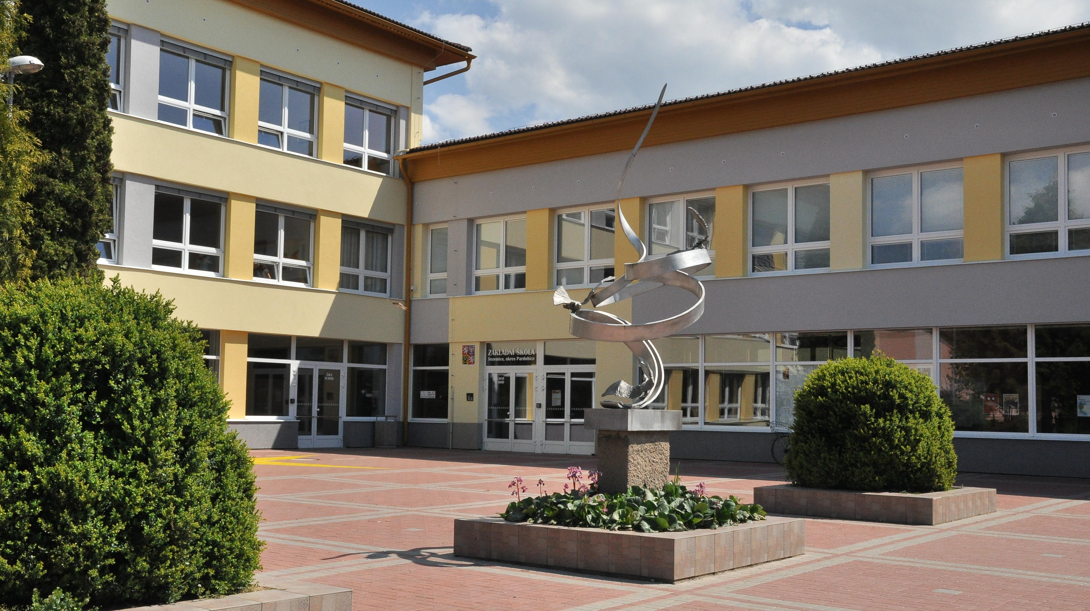
This is our school!

Slide 5
And this is US!

Slide 6
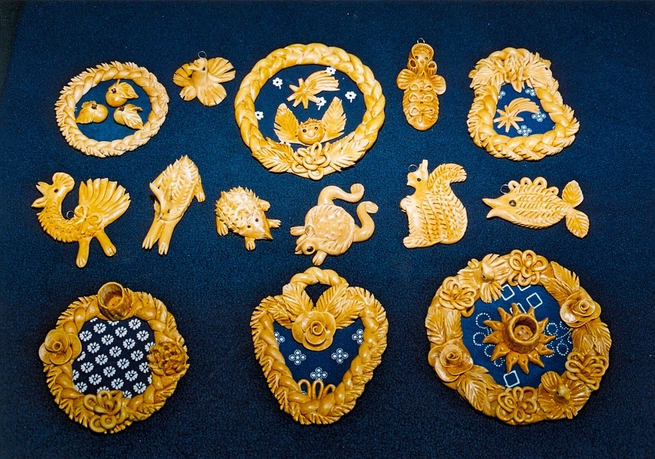
The decorations we’ve made
we’re sending you the so-called “Vizovické ozdoby” – these are made of flour and water but are not edible
the tradition of making these is hundreds of years old

Slide 7
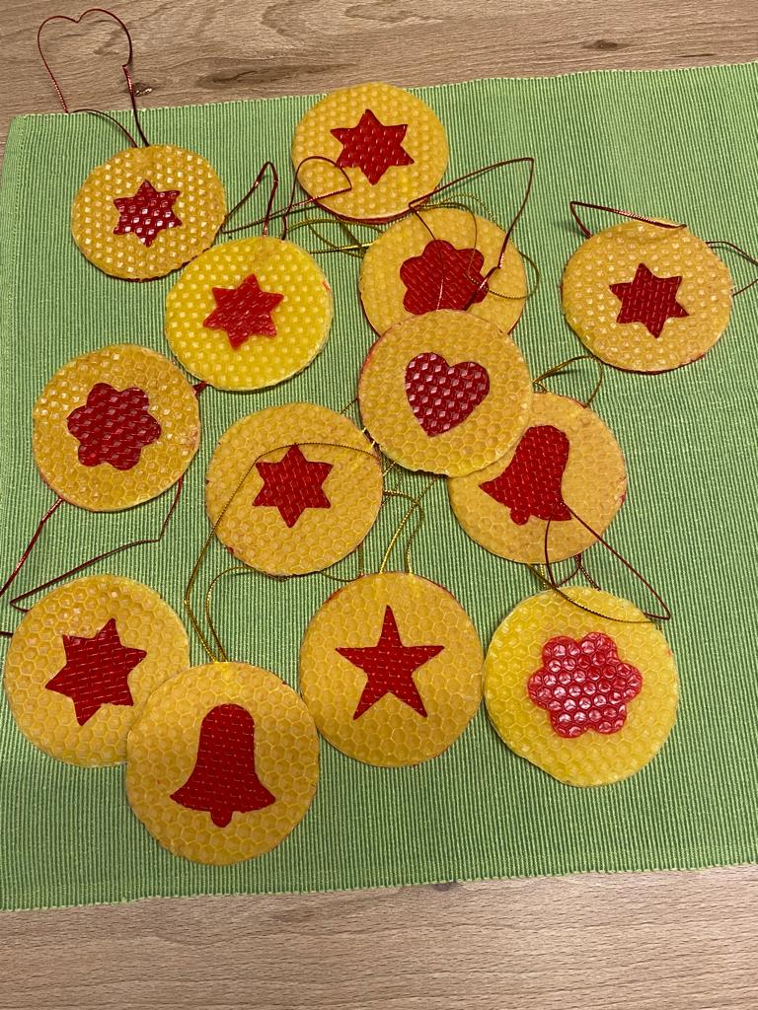
The decorations we’ve made
we’re also sending you these – traditional decorations made of beeswax
they started to be manufactured at the end of the 19th century

Slide 8
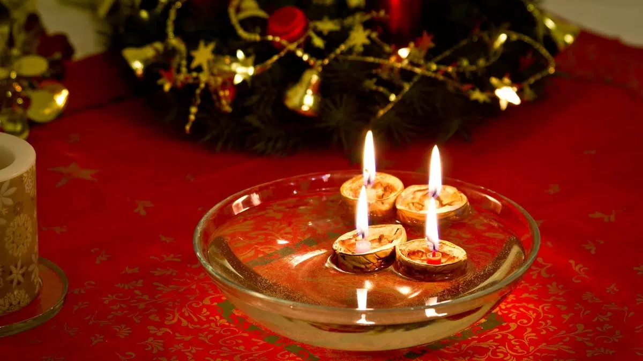
How do we celebrate Christmas?
on December 24th, some people decide to fast until dinner (sometimes we say you might see a “golden pig” if you do so, but it’s more of a Christian tradition)
throughout the day, the children try to be good and wait for Ježíšek (Baby Jesus) to bring them presents in the evening
once it gets dark, families gather to have a large Christmas dinner together (the tradition is to have a fish soup, carp, and a potato salad)

Slide 9
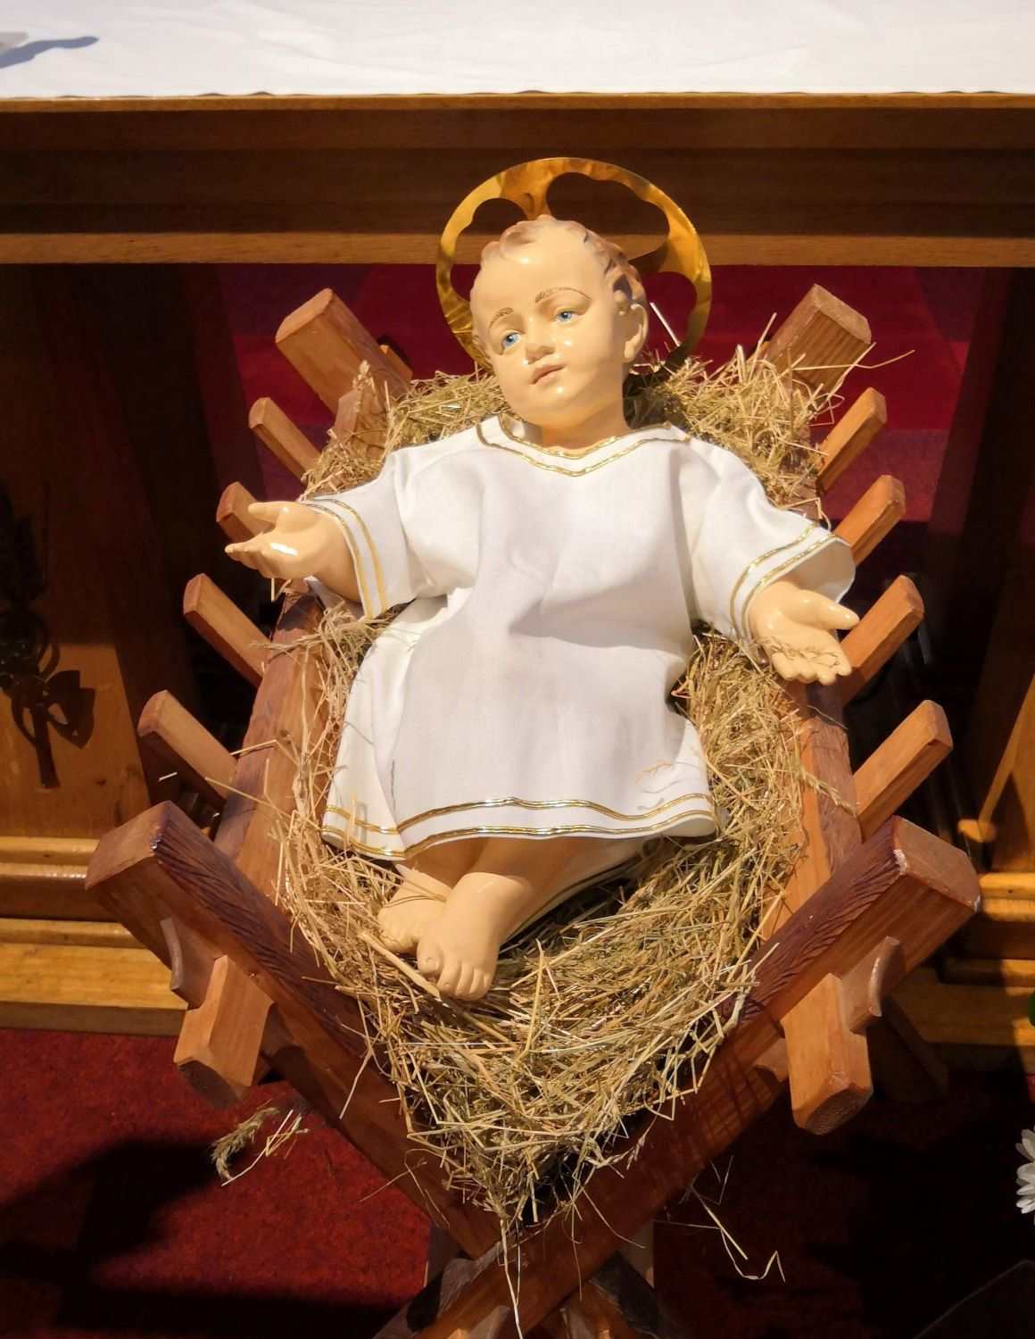
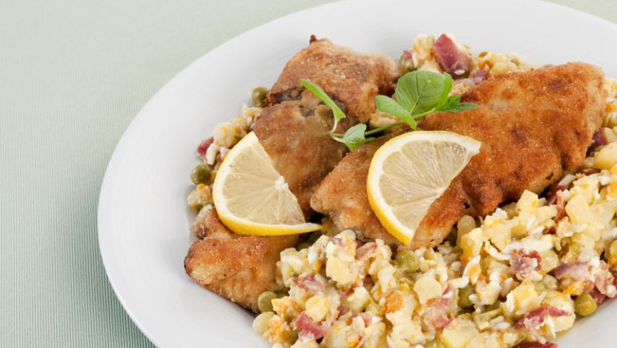

Slide 10
After dinner
after dinner, the bell rings, and this is a signal that Ježíšek has arrived, and the presents are here
the family gathers around the Christmas tree and the youngest in the family usually distributes the presents

Slide 11
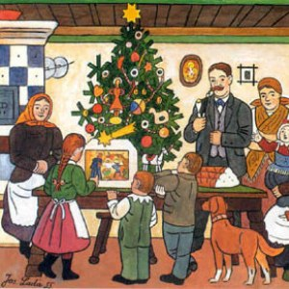
After December 24th
on Dec 25 and 26, many people visit their relatives to exchange gifts with them and spend time together
people also watch fairytales on TV, sing carols, or go to church
these two days are considered national holidays

Slide 12
Non-Christians
even though most of our population is atheist, people still celebrate Christmas based on Christian traditions
some people opt out of fasting or going to the mass
other religious minorities celebrate Christmas in their own way

Slide 13
In 2023, we wish you…
…much love, success, happiness, stability, peace, and friendship!

Slide 14
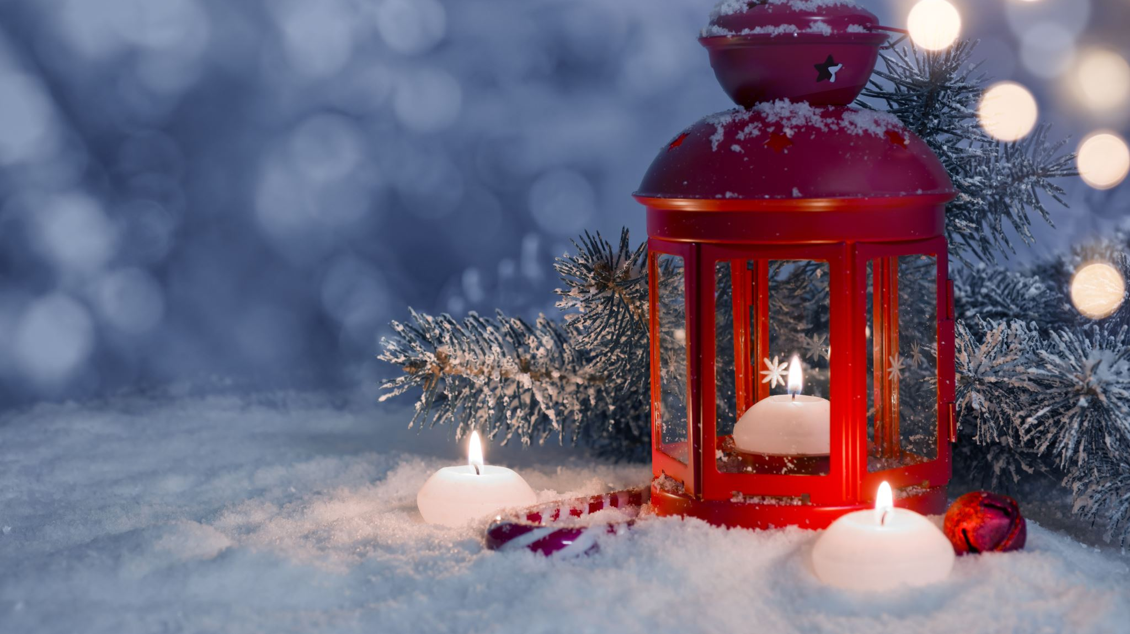
Veselé vánoce!

